Slide 1

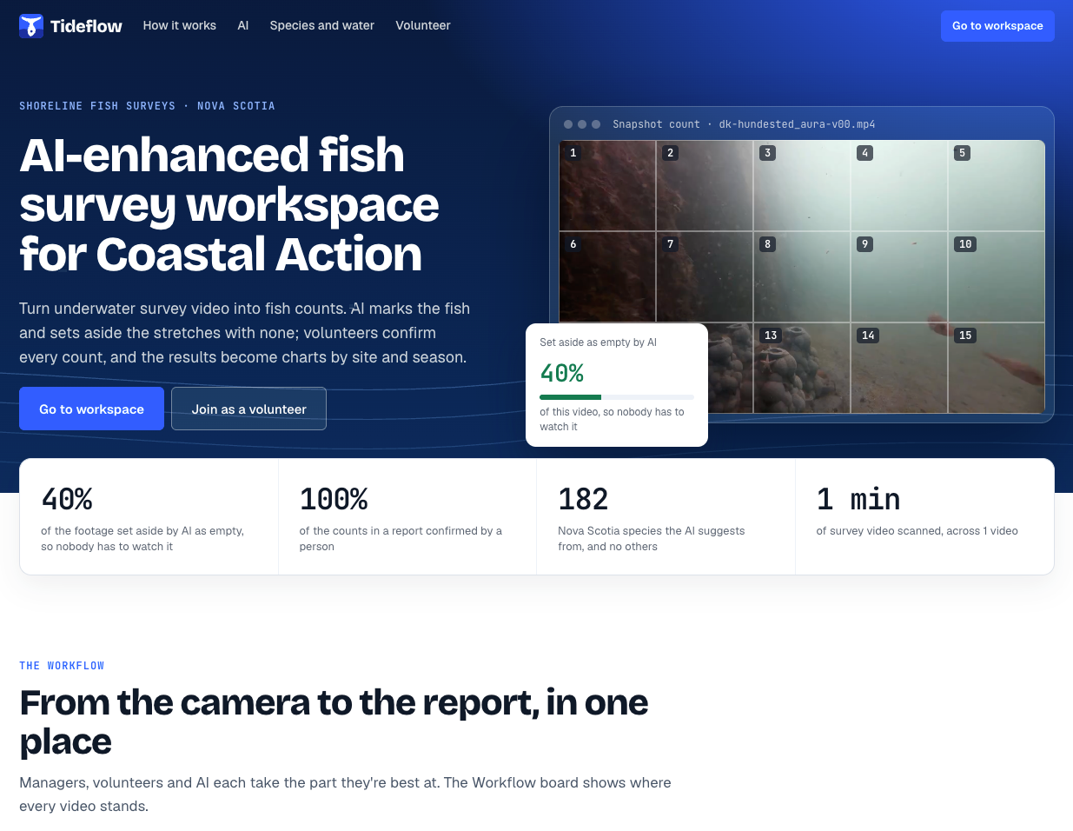


AI-enhanced fish survey workspace for Coastal Action
Scan to open the live demo
https://tideflow.ligangyan.com
Nov 9, 2026 · RBC Hubhacks · The Coastal Coders Anthony, Ethan, Ligang, Noah, Ryan (In alphabetical order)
Notes:
Hello everyone, we are Coastal Coders from NSCC's IT for AI program.
My name is Ligang, and I'm the team leader. Passing it over to...

Slide 2
What Coastal Action asked us to solve
Species list
“Outdated species list, especially with climate change drivers.”
Visibility
“Low visibility and high interference from natural materials in the water (algae, sediment, grass, etc.)”
Fatigue
“Reliance on human detection and associated errors and fatigue.”
Staff cost
“Staff cost of analyzing video data.”
No cloud AI
“…we would not be able to support a publicly hosted AI model.”
Notes:
You know these five problems better than anyone, so we won't repeat them.

Slide 3
Our Solution
Notes:
Our Solutaion

Slide 4
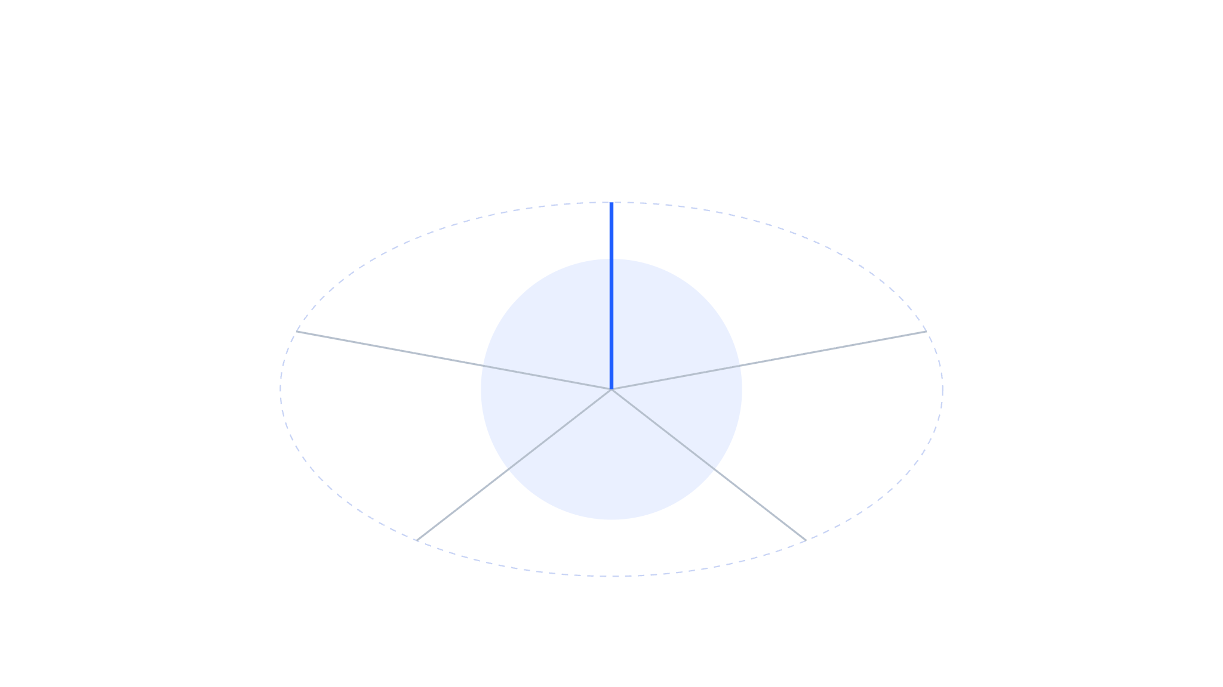





Tideflow: AI-enhanced workspace
Workflow
Surveys
Species wiki
Tideflow
Self-hosted
local AI
Data analysis
Team
Notes:
Looking across all five problems, the common thread was clear: serious scientific research held back by a lack of IT infrastructure and AI support. Our goal is simple: empower these teams with the tech foundation and AI capabilities to accelerate their current work and drive future breakthroughs.
This is Tideflow: an on-device platform powered by both open-source and custom-trained computer vision models.
Around it are Workflow, Surveys, Species Wiki, Data analysis, and Team.
Next, Noah and Anthony will introduce more for us

Slide 5

Counting Before
VLC · 22:00 / 35:47
Excel · analysis sheet
Time | Fish | Inv. | Unk. | Notes
19:00
20:00
21:00
22:00 | 102
23:00
24:00
25:00
Pause the frame
Draw a grid
Dot every fish
Add up, type it in
× 15
Notes:
Speaker B, 20 seconds. This is Coastal Action’s own screenshot of how a frame gets counted. Pause the frame, draw a grid, put a dot on every fish, write a number in each cell, add them up: 102 fish in this one frame. Then type it into Excel, and do it again at the next point.

Slide 6
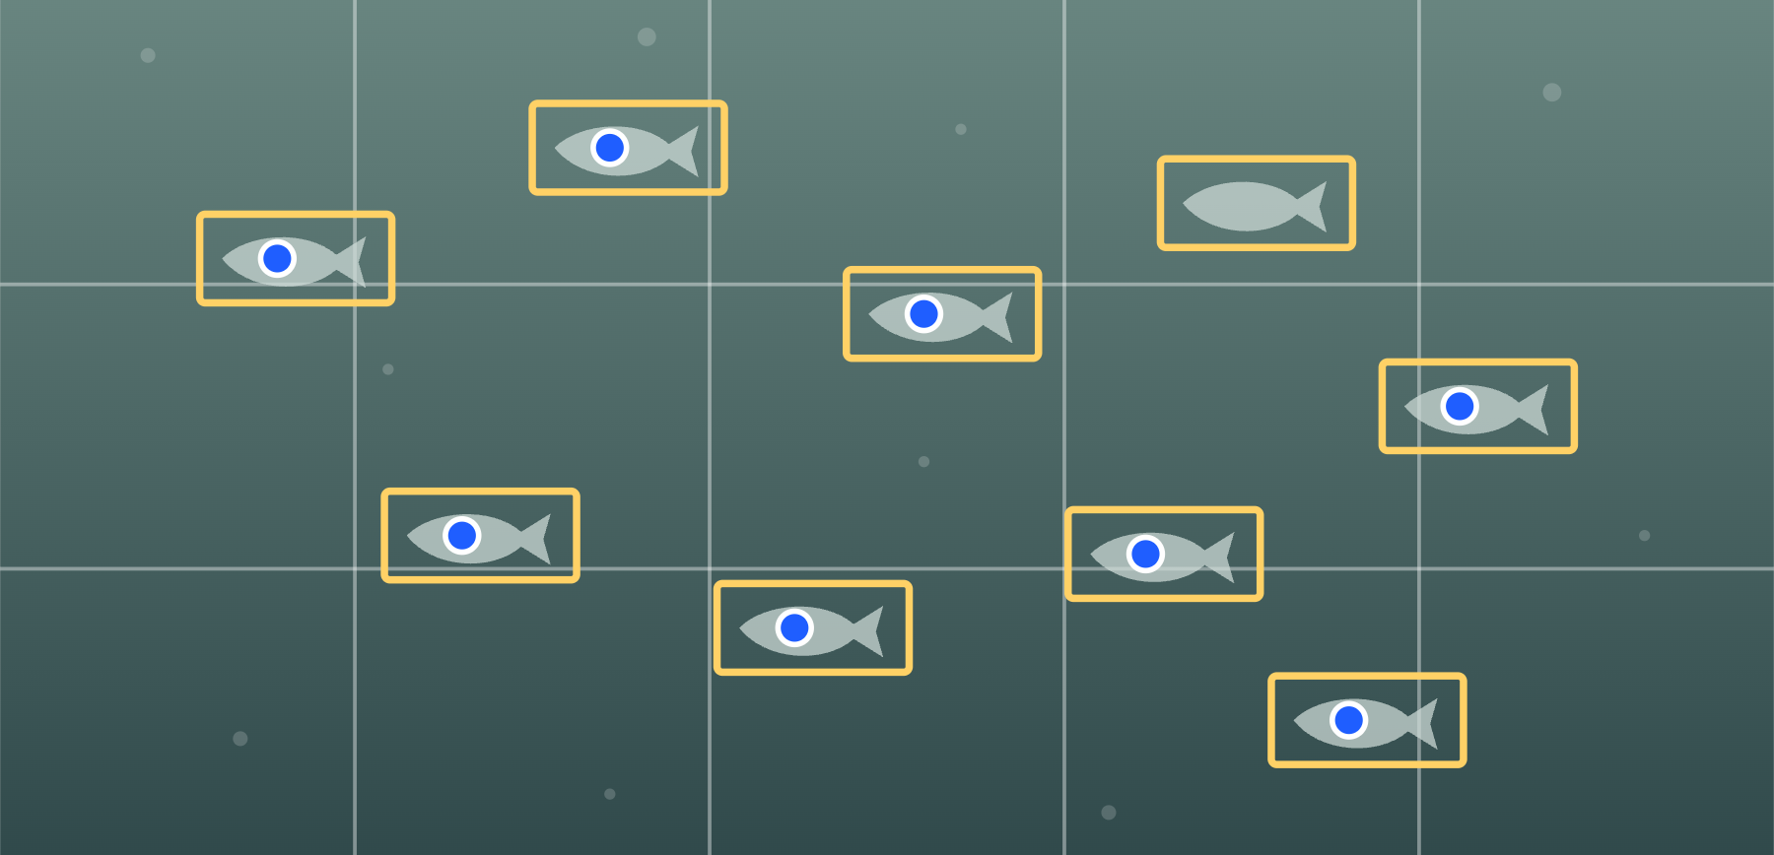

Counting Now
Tideflow · T1-STAT2 411
Point 13 of 15
Total fish
Invert.
Unknown
8
0
1
Cunner
Pollock
Visibility
5
2
Same
Notes
Fish at far right too faint
Saved · you counted 8 · AI saw 9
Your number stands. One box to check.
21:55
22:05
0.25×
Frame opens itself
Grid is ready
Click every fish
Adds up, AI checks
× 15
Notes:
Speaker B or C, 20 seconds. Same steps, one window. The frame opens at the right second with the grid already on it. Click each fish, the blue dots, and the total adds itself up. After you save, the AI boxes appear, and here it found one you missed. Your number stands; you decide. The models are open source, run on their machine, and are not yet tuned on Coastal Action footage. The frame and numbers on this slide are an illustration.

Slide 7



Species wiki
Tideflow · Species
Sync regional records
Cunner
Native
Pollock
Native
Mummichog
Native
Green crab
Invasive
Silverside
Native
Unknown
Ask expert
Unknown
Ask expert
Unknown
Ask expert
Notes:
Speaker B, 5 seconds. The species list grows from what we confirm on video and from public regional records. Anything nobody can name is kept for an expert. The names here are an illustration; replace this slide with a screenshot once the page exists.

Slide 8
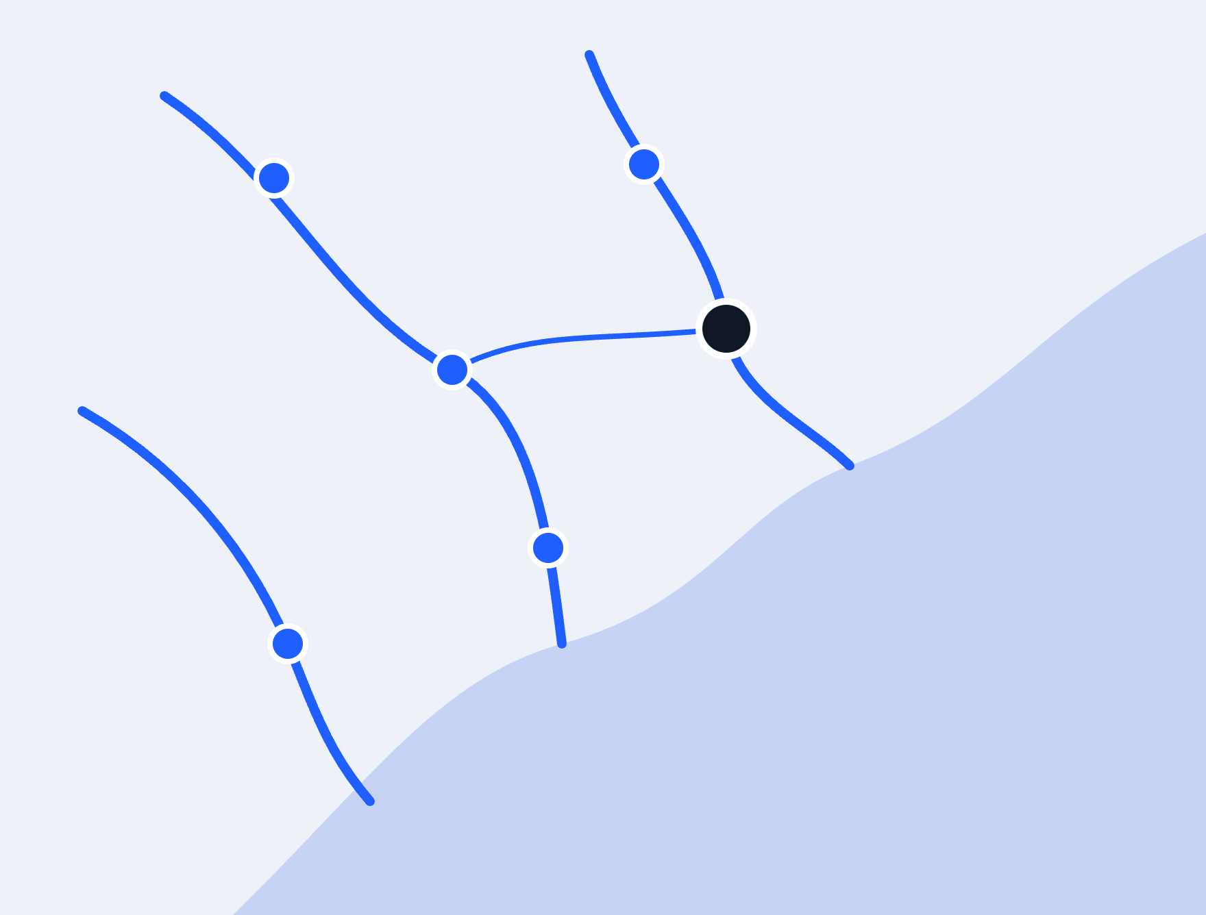

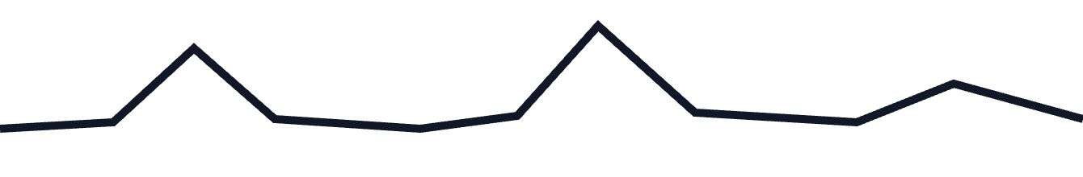

Water quality
Tideflow · Water quality
Public data
Water temperature
Turbidity
Flow
Notes:
Speaker B, 5 seconds. Coastal Action’s public river monitoring data, in the same workspace: stations on a map, statistics and charts beside them. The map and lines are an illustration; replace this slide with a screenshot once Ethan’s page is in.

Slide 9
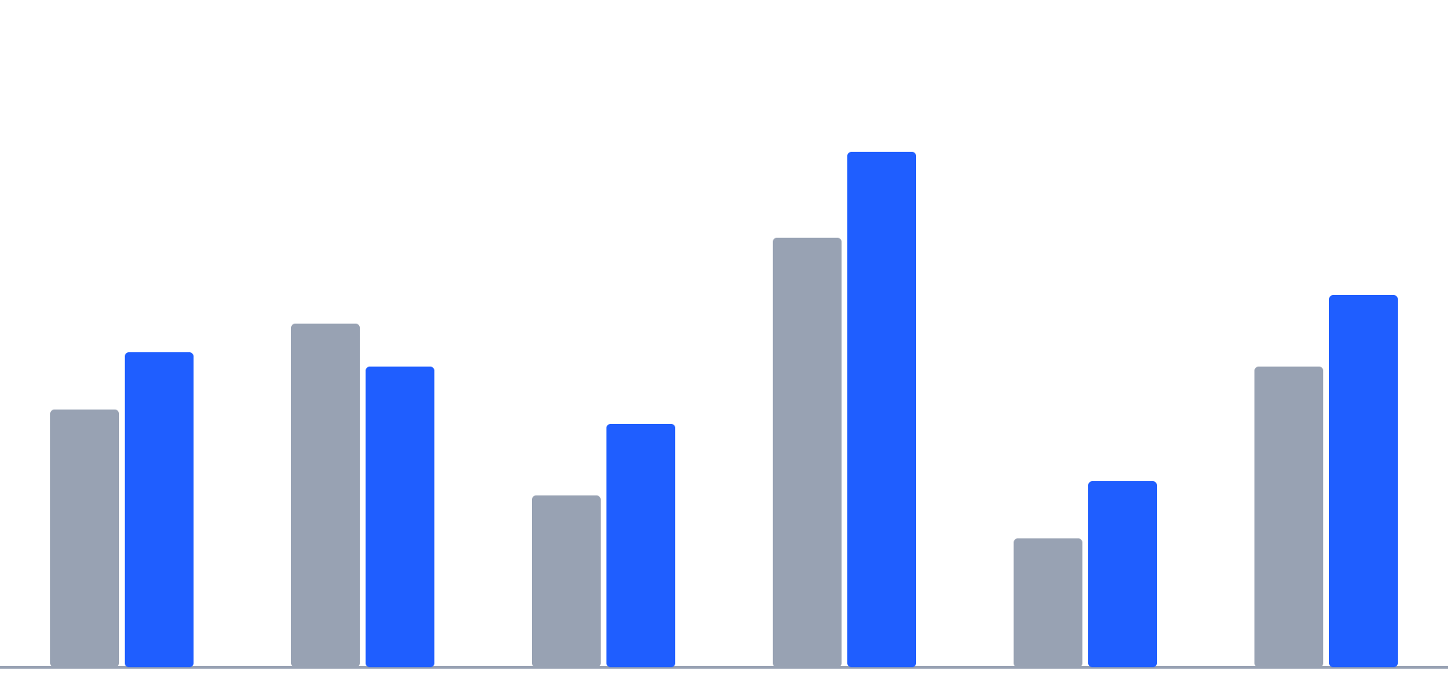
Reports
Tideflow · Reports
Mahone Bay
MeanCount by station
Fall
Spring
Species seen
QC agreement
Who counted
Export CSV
T1·S1
T1·S2
T1·S3
T2·S1
T2·S2
T2·S3
Notes:
Speaker B, 5 seconds. Every approved count rolls up by station and season, so you can see if a site is improving. The bars are an illustration; replace this slide with a screenshot once the page exists.

Slide 10
Q&A
Thank you.
tideflow.ligangyan.com
Notes:
Leave this up during questions; people can scan it. If asked about limits: the detector is open source and not tuned on Coastal Action footage; AI counts are unverified until blind points exist; species suggestions are not validated for Nova Scotia. If asked what is next: re-analyse one past season beside the Excel results, then team mode for the 2027 season, then a detector fine-tuned on their own labelled footage.

